Slide 1
Graphs
A non-linear data structure

Slide 2
Definition
A graph G(V,E) is defined as set of vertices (nodes) and inter-related edges (arcs).
V={v1, v2, v3, v4} , E={e1, e2, e3, e4} e1
e2 e4
e3
V1
V2
V3
V4

Slide 3
Basic Terminologies
Directed Graph or Digraph: A graph G(V,E) is a digraph if its edges are directionally oriented.
A digraph may be strongly connected or weakly connected.
A directed graph is strongly connected if there is a path between any two pair of vertices.
Strongly connected Digraph Weakly connected Digraph
A
B
C
A
A
B
C
B
C
Note: The nodes in a strongly connected digraph will have an indegree of at least 1

Slide 4
Undirected Graph: A graph G(V,E) is said to be undirected if its edges are not directionally oriented.
Weighted edged graph/Network: A graph G(V,E) is said to be a weighted edged graph if its edges are associated with some values or weights.
10 20
15
Complete graph: A graph G(V,E) is said to be complete if there exists an edge between every vertices. A complete graph with n vertices will have (n(n-1))/2 edges.
Note: A strongly connected digraph is a complete digraph
V1
V2
V3
V4
A
B
C
V1
V2
V5
V3
V4

Slide 5
Cycle: A cycle in a digraph is a path of length at least 1 with starting and ending nodes are the same.
Length of the cycle:3
Acyclic Graph/DAG: A digraph with no cycles.
DAG-Directed Acyclic Graph
Tree- an acyclic graph
A
B
C
A
B
C

Slide 6
Degree of a vertex: no. of incoming edges + no. of outgoing edges of a vertex.
Indegree of a vertex: no. of edges entering a vertex.
Outdegree of a vertex: no. of edges leaving a vertex.
Note:
A node whose indegree is 0- source node (V1)
A node whose outdegree is 0- sink node (V5)
V1
V2
V5
V3
V4
Vertex | Indegree | Outdegree | Degree
V1 | 0 | 4 | 4
V2 | 1 | 3 | 4
V3 | 2 | 2 | 4
V4 | 3 | 1 | 4
V5 | 4 | 0 | 4

Slide 7
Graph representation
V2
Adjacency matrix
Simple but takes a time complexity of O(n²)
Adjacency list
Uses pointers therefore requires extra memory space
Adjacency matrix Adjacency list
V1
V5
V3
V4
V | V1 | V2 | V3 | V4 | V5
V1 | 0 | 1 | 1 | 1 | 1
V2 | 0 | 0 | 1 | 1 | 1
V3 | 0 | 0 | 0 | 1 | 1
V4 | 0 | 0 | 0 | 0 | 1
V5 | 0 | 0 | 0 | 0 | 0
V1
V2
V3
V4
V5
V2
V3
V4
V5
V3
V4
V5
V4
V5
V5

Slide 8
Graph Traversals

Slide 9
Graph traversal means visiting every vertex and edge exactly once in a well-defined order.
Graph Traversals
Depth First Search (DFS)
Breadth First Search (BFS)

Slide 10
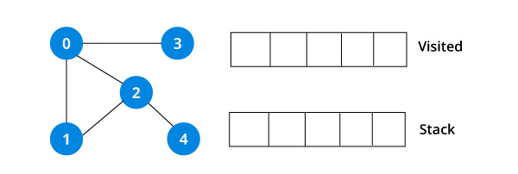
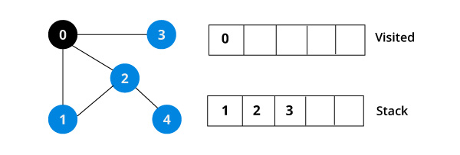
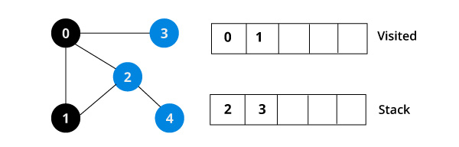
DFS

Slide 11
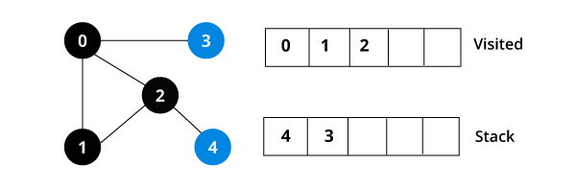
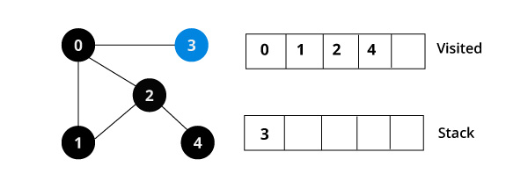
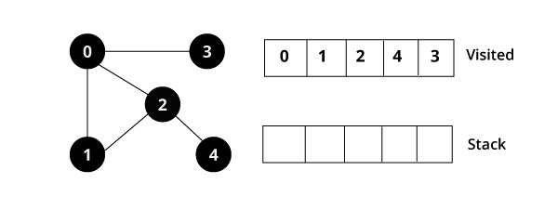

Slide 12
DFS-Pseudo code
DFS-recursive(G, s) //Where G is the graph and s is the source node
mark s as visited
for all neighbours w of s in Graph G:
if w is not visited:
DFS-recursive(G, w)
Data structure used stack
Example of recursive backtracking

Slide 13
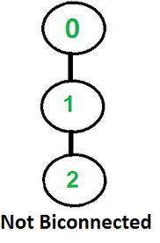
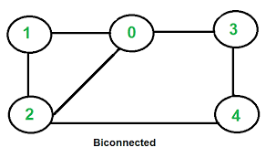
Applications of DFS
To check an undirected graph is connected or not (A connected graph mean that every node is reached through some path).
To check the connected undirected graph is bi-connected or not. (graph is still connected even after removing a vertex or a graph with no articulation points)
To check for DAG (Directed Acyclic graph).

Slide 14
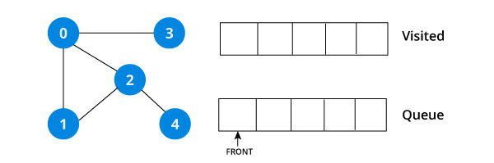
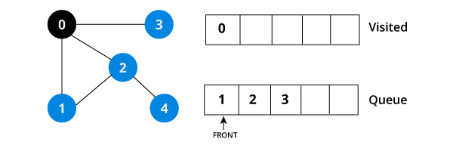
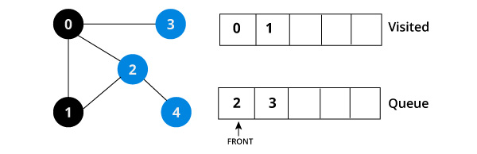
BFS

Slide 15
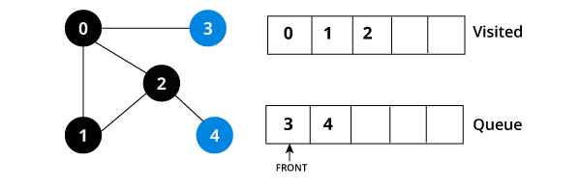
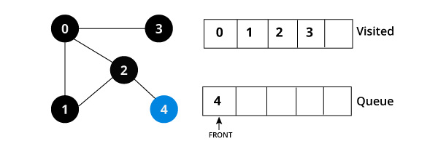
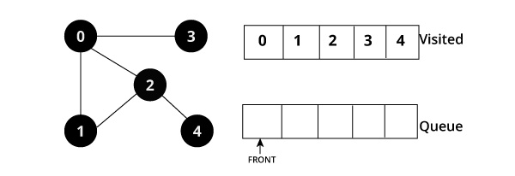

Slide 16
BFS-Pseudo code
BFS (G, s) //Where G is the graph and s is the source node
let Q be queue.
Q.enqueue( s ) //Inserting s in queue until all its neighbour vertices are marked.
mark s as visited.
while ( Q is not empty)
//Removing that vertex from queue,whose neighbour will be visited now
v = Q.dequeue( )
//processing all the neighbours of v
for all neighbours w of v in Graph G
if w is not visited
Q.enqueue( w ) //Stores w in Q to further visit its neighbour
mark w as visited.
Data structure used Queue

Slide 17
Applications of BFS
Shortest path problems
Topological sorting (sort the vertices of graph in linear order)

Slide 18
Properties of BFS and DFS
1. Both BFS and DFS when originating from node v in a digraph G create a tree, whose nodes are just those visited by the algorithm and whose arcs are those traversed. The algorithms BFS and DFS create a forest of trees which spans G.
2. Both the BFS and DFS algorithms run in time O(V+E) when using adjacency lists representations of the graphs. When adjacency matrix format is used, they run in time
O(V ²).
3. The call to DFS (v) does not terminate until all nodes reachable from v have been visited.
4. If w is reachable from v and v is visited before w by DFS, then w is a descendant of v in the DFS forest.
5. Suppose that BFS or DFS is run on a digraph G and let (u, v) Є E(G) be an arc of G. This arc is called a tree arc if it belongs to one of the trees of the forest formed by the search algorithm. There are 3 types of non-tree arcs. The arc is a forward arc if u is an ancestor of v in the forest (note that they must belong to the same tree). A back arc is the same, but with “ancestor” replaced by “descendant”. Finally, the arc is a cross arc if neither u nor v is an ancestor of the other (they may or may not belong to the same tree).
For BFS, forward arcs do not exist. All four types of arcs can arise with DFS.
Note: Tree arc is a forward arc but forward arc is not a tree arc.

Slide 19
Shortest path Algorithm- Dijkstra’s Algorithm-Greedy Technique- Single Source Shortest Path (SSSP) algorithm
800
410 612 310 200
2985 400
1421
Initial Table
B
A
E
C
D
T(w).dist=min(T(w).dist, T(v).dist+C_{vw})
V | Known | D _{v} | P _{v}
A | 0 | 0 | 0
B | 0 | ∞ | 0
C | 0 | ∞ | 0
D | 0 | ∞ | 0
E | 0 | ∞ | 0

Slide 20
V | Known | D _{v} | P _{v}
A | 1 | 0 | 0
B | 0 | 800 | A
C | 0 | 2985 | A
D | 0 | 310 | A
E | 0 | 200 | A
W stands for adjacent nodes from v. Here A is V and W are B, C, D and E
T(B).dist=min(∞,0+800)=min(∞,800)
800 is minimum therefore update the table contents for Dv and Pv.
Known is 1 indicates the current processing node (V).
Using the formula, update the other values similarly.
V | Known | D _{v} | P _{v}
A | 1 | 0 | 0
B | 0 | 800 | A
C | 0 | 2985 | A
D | 0 | 310 | A
E | 1 | 200 | A
The next node to be processed is the node that has the minimum distance.
Now V is E and W is A and D. Node A is already processed
T(D).dist=min(310,200+400)
Min is 310
V | Known | D _{v} | P _{v}
A | 1 | 0 | 0
B | 0 | 800 | A
C | 0 | 1731 | D
D | 1 | 310 | A
E | 1 | 200 | A
The next node to be included D. V is D, W-B,C
T(B).dist=min(800, 310+612)=min(800,922)-no updation needed
T( C).dist=min(2985,310+1421)=min(2985, 1731)- update the table contents for C.
This means that reaching C from A directly is covering more distance than reaching C through D

Slide 21
V | Known | Dv | Pv
A | 1 | 0 | 0
B | 1 | 800 | A
C | 0 | 1210 | B
D | 1 | 310 | A
E | 1 | 200 | A
V-B, W-C
T( C).dist=min(1731, 800+410)=min(1731,1210)- update the contents for C
Reaching C through B is more shorter than D
V | Known | Dv | Pv
A | 1 | 0 | 0
B | 1 | 800 | A
C | 1 | 1210 | B
D | 1 | 310 | A
E | 1 | 200 | A
V-C, no W as all adjacent nodes are visited or processed already
Result
A->B=800(through A)
A->C=1210(B)
A->D=310(A)
A->E=200(A)

Slide 22
Using A as source node find the shortest path to reach all other nodes
250
450
700 1730 900
500
300
A
B
E
C
D

